Slide 1
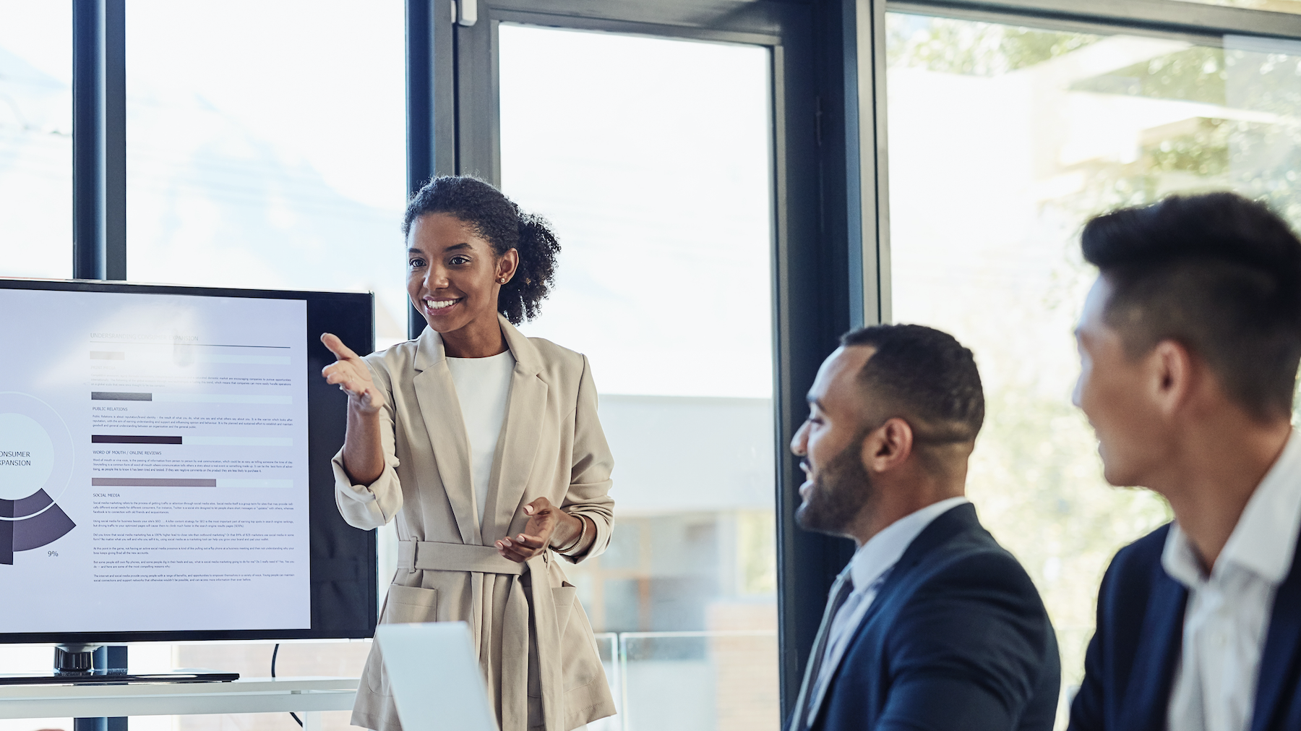
LAPR2 Global Report
Group 12 DC:
Daniel Monteiro;
Hugo Miranda;
Mário Borja;
Guilherme Marques;
Jorge Cunha.
Karysia Mendes

Slide 2
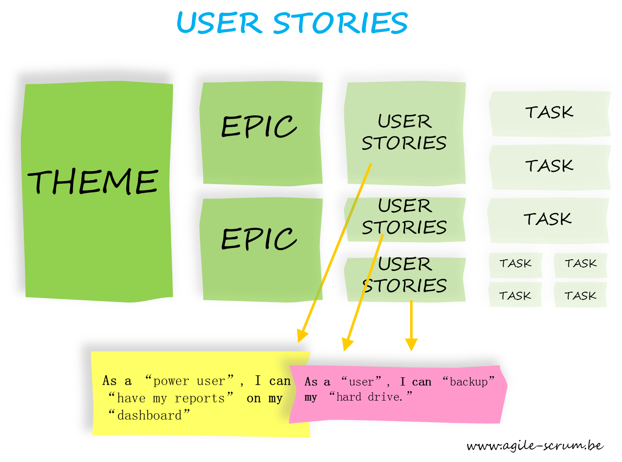
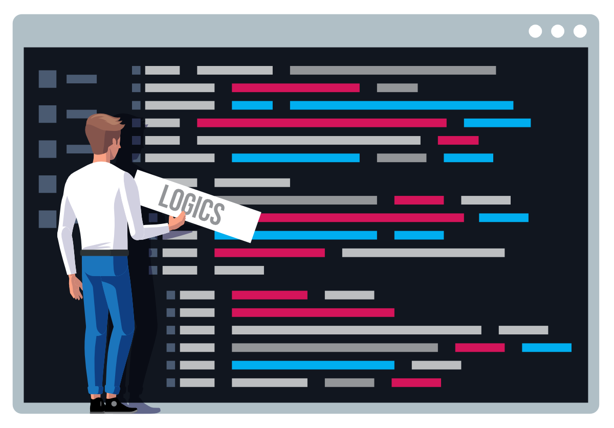
What Has Been Done
Sprint A
In the Sprint A we finished supplementary specification (FURPS+)
We also created the Glossary and we added terms, expressions and acronyms
We did on PlantUML the Use Cases diagrams for each actor as well
We elaborate our Domain Model on Visual Paradigm

Slide 3
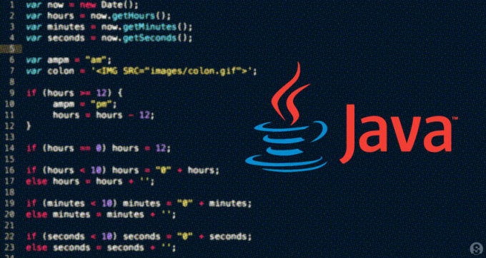

What Has Been Done
Sprint B
Firstly what we did was corrections on the FURPS+;
After that we added some new terms and acronyms to our glossary;
We fixed our Use Case Diagram on PlantUML with the corrections that the teacher told us to do;
We created a new Domain Model on PlantUML, adding the attributes as sugested by the teacher;
We designated User Stories to each team member;
We registered everything on the Trello Board;
And we Programmed each user story.

Slide 4

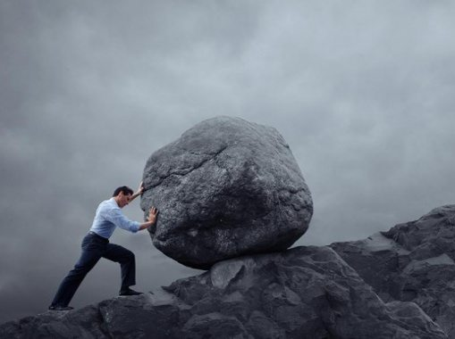
What have we struggled with
We have struggled with resolving problems related to the first sprint, that made us far behind comparing to the rest of the groups.
The Work made together wasn't enough, some of us didn't start early.
We struggled with one group member that didn't do is part of the Work and that made us lack on the user stories and on the programing.

Slide 5
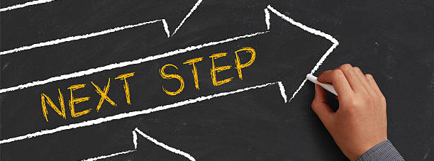
Next Steps
Together trying to resolve the difficulties about one element of the group.
Finishing the sprint b of the team member that didn't do is part.
And starting the sprint C by resolving the earlier mistakes(Sprint B Corrections).

Slide 6
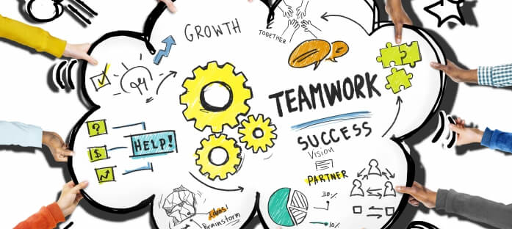
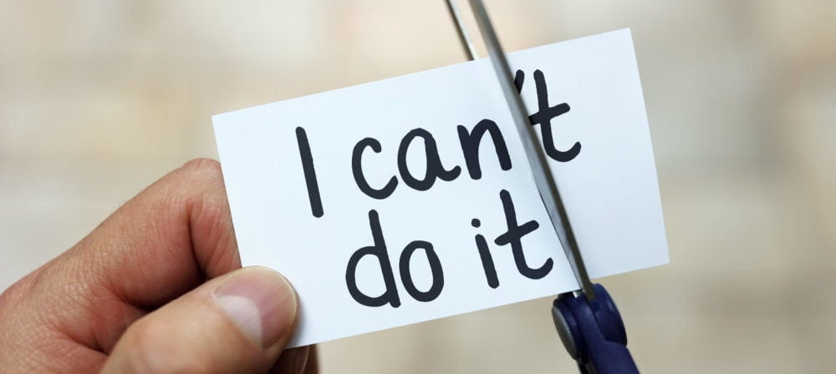
Blocking Issues:
We had some blocking issues on the User Stories;
Also, we had one error that we couldn’t fix, that was related to java the company.
More specific, we couldn’t run the program because of it.

